Slide 1

ONLINE BANKING SYSTEM
Team Number: 6
Mentor Name: N. KATHIRESAN

Slide 2
TEAM MEMBERS
BINDU ANJANAPPA (Configuration Manager)
ABHIJEET ANAND
AVINASH RAMESH
JYOTSNA SURVE
RISHABH WAYKOLE
ROHIT KANOJIA

Slide 3
OBJECTIVES
PROJECT CONCEPTION
FUNCTIONAL COMPONENTS OF THE PROJECT
MODULES
UML DIAGRAMS

Slide 4
PROJECT CONCEPTION
The project aims at developing an Online Banking System (OBS) for Account holders and Bank admin which enables customers of a bank or other financial institution to conduct a range of financial transactions through the financial institution websites.
This is an integrated system that contains the Bank Admin element and the Account Holder element.

Slide 5
FUNCTIONAL COMPONENTS
There are two categories of people who would access the system viz. Account Holders & Bank Admin:
Account holders :
Login into the system using his/her credentials.
View Mini /Detailed statement of all the accounts (Multiple accounts, if any can be viewed)
Request for change in communication address/mobile number for bank account
Request for cheque book
Track service request
Fund Transfer
Change password
Bank Admin :
Create a new Account upon request.
Can view the reports of overall transactions on daily/monthly/quarterly/yearly basis.

Slide 6
MODULES
Account Holder:
Login Screen
Log in/Sign in
Home Page
View Mini /Detailed statement page
Request for change in communication address/mobile number for bank account page
Request for Chequebook
Track service request page
Fund Transfer page
Change password

Slide 7
MODULES(contd.)
Bank Admin:
Log in/Sign in
Create New Account page
View transactions of all accounts

Slide 8
MODULES(contd.)
Log In:
Login module is common for all the users of the system viz. Account Holders & Bank Admin
Basic functionalities of the login module are as follows:
Taking login credentials from the user.
If given credentials are wrong, show appropriate message.
More than 3 attempts must lock the account.
If login succeeds, user will be navigated to his/her respective page as per his/her role.

Slide 9
MODULES(contd.)
4. Forgot password option:
This should ask the user to answer a specific question which was specified during registration.
On answering the security question correctly, a new login password is generated, which is sent to the user via email.
II. Create New Account Page:
This page must accept account holder name, address, mobile number, email-id, account type ,opening balance and generate the account number .

Slide 10
MODULES(contd.)
III. View Transactions Of All Accounts:
This link displays the transaction details of all account on daily /monthly/yearly basis.

Slide 11
MODULES(contd.)
Account Holder:
View mini/detailed Statement Page
Request for change in communication address/mobile number for bank account page
Request for Chequebook
Track service request page
Fund Transfer page
Change Password

Slide 12
MODULES(contd.)
I. View mini/detailed Statement Page:
Mini Statement:
This will show the last 10 transactions
Detailed Statement:
This will show the transaction details for the period selected
Account holder can have multiple accounts. He/She should be able to view statements of all his/her accounts

Slide 13
MODULES(contd.)
II. Request for change in communication address/mobile number for bank account page:
Displays current communication and Mobile number details and allows the user to change the address of communication and mobile number
III. Request for Chequebook:
This Accepts the request and displays service request number.
A chequebook request is always in Open state. Other valid states are dispatched, issued or returned.

Slide 14
MODULES(contd.)
IV. Track service request page:
This link helps the user to know the status of the service requested like request for cheque book
Following should be displayed at the end of the page
V. Fund Transfer page:
Your own bank account across India:
Allows transferring from user’s own accounts.

Slide 15
MODULES(contd.)
2. This page displays two drop down boxes each listing out all accounts of that particular user. One is a 'from' dropdown box to select the account from which he/she want to transfer funds. The other is 'pay' dropdown box to select the account to which he/she want to transfer the funds.
Other account of same bank across India:
Funds can be transferred to other accounts of the same bank .
Select the payee (person user want to pay to) from the list of payees in the drop down.

Slide 16
MODULES(contd.)
3. Click the Pay button: user will be prompted to enter the transaction amount and transaction password. On entering the correct transaction password, transaction will be completed
The maximum amount of funds that can be transferred per day is Rs. 10 lakhs.
There is no limit on Funds transfer to “your own Bank Account”.
VI. Change Password:
Password change option allows the user to provide a new password for login.

Slide 17
Account Holder Module
Track Service Request
View Statements
Login
Fund Transfer
Account Holder
Request for Change in Address/Mobile No.
Request for Chequebook
Notes:
Add instructor notes here.

Slide 18

Bank Admin Module
Update/Delete Account
Login
Create Account
Admin
View Reports of Overall Transactions
Notes:
Add instructor notes here.

Slide 19
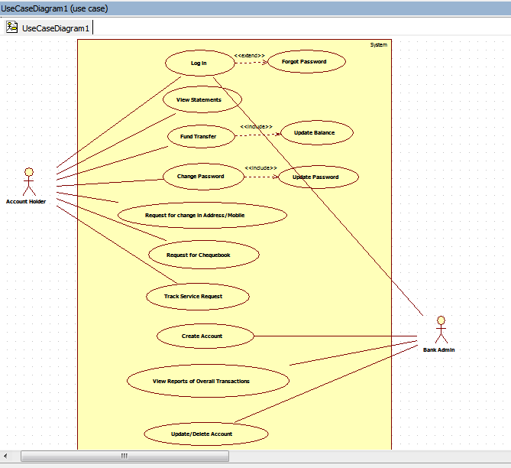
USECASE DIAGRAM

Slide 20
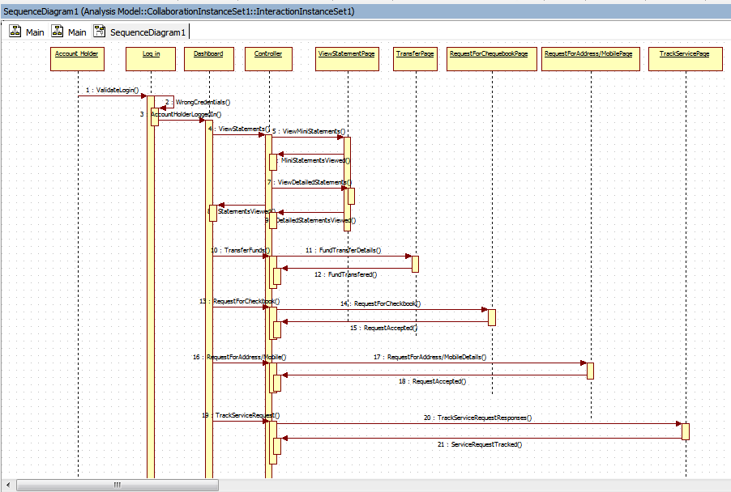
SEQUENCE DIAGRAM
For Account Holder:

Slide 21
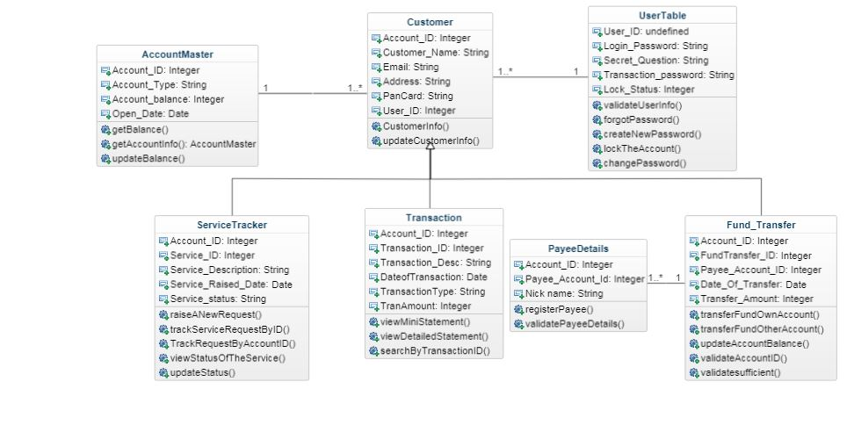
CLASS DIAGRAM
For Account Holder:

Slide 22
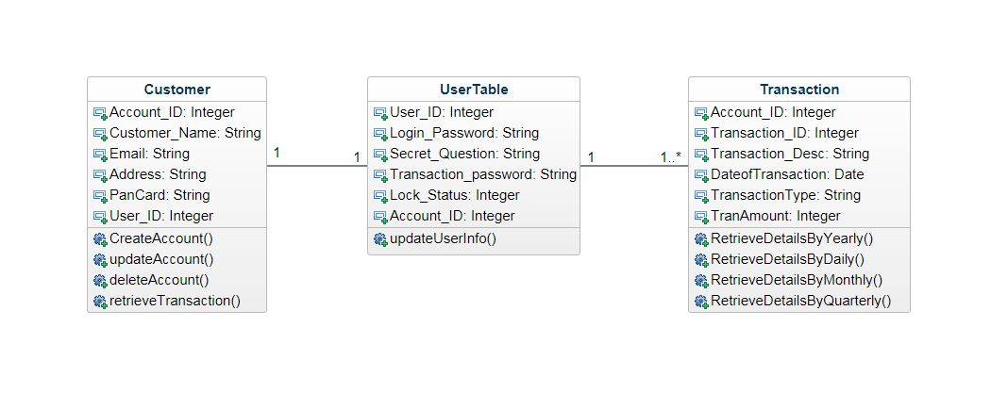
CLASS DIAGRAM
For Bank Admin:

Slide 23
Q & A

Slide 24
THANK YOU

